Slide 1
Data Driven Decisionmaking
INTR 490
COLL 200
Notes:
<number>

Slide 2

Notes:
<number>

Slide 3
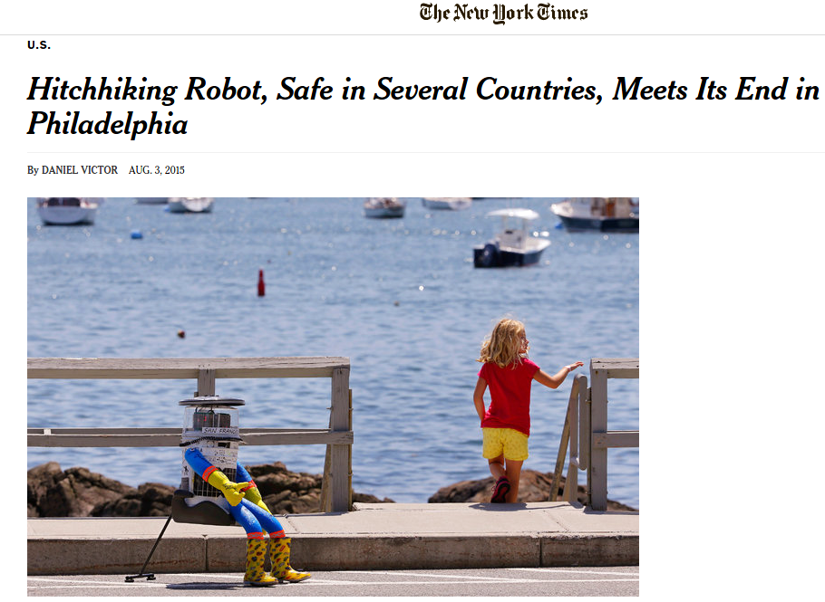
Notes:
<number>

Slide 4
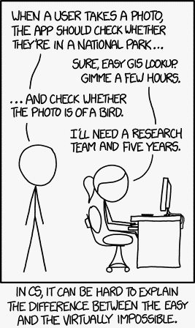
Notes:
<number>

Slide 5
452*12
Notes:
<number>

Slide 6
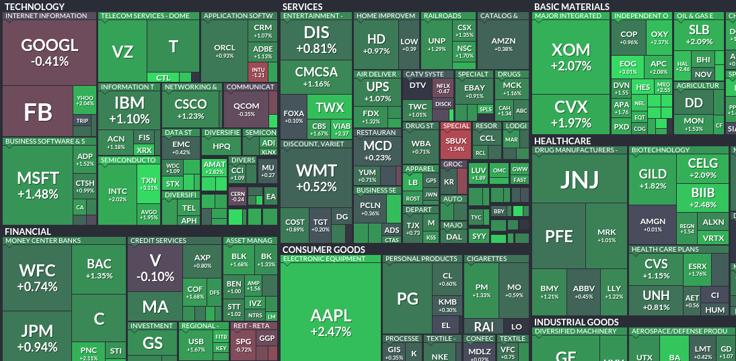

Notes:
<number>

Slide 7
452*12 = 5,424 by the way
Notes:
<number>

Slide 8
So, what?
This course is all about giving you the skill to leverage data in a real world case.
Today, we're going to take a brief tour through the variety of data in decisionmaking.
The first half of the semester, you'll work on a real world project for which all the data and methods already exist.
The second half of the semester, in groups you will work with a partner organization (Save the Children, World Bank, US Army Corps, White House OSTP) to work on an unsolved problem.
Notes:
<number>

Slide 9


Notes:
<number>

Slide 10



Notes:
<number>

Slide 11
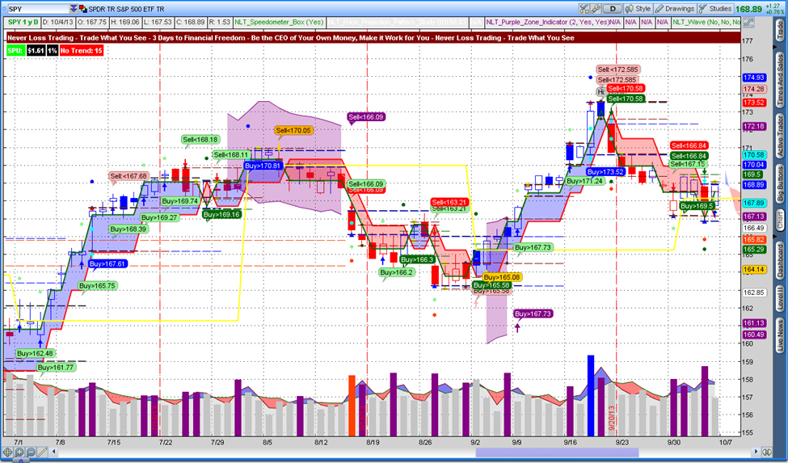
Notes:
<number>

Slide 12
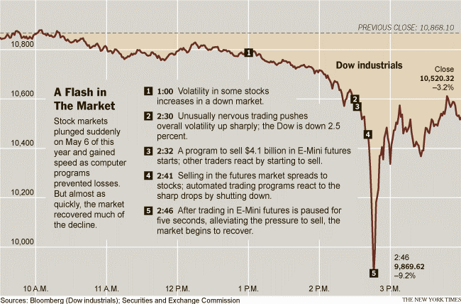
Notes:
<number>

Slide 13
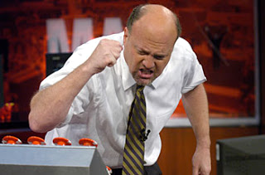
Notes:
<number>

Slide 14
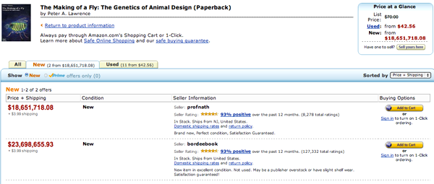
Notes:
<number>

Slide 15

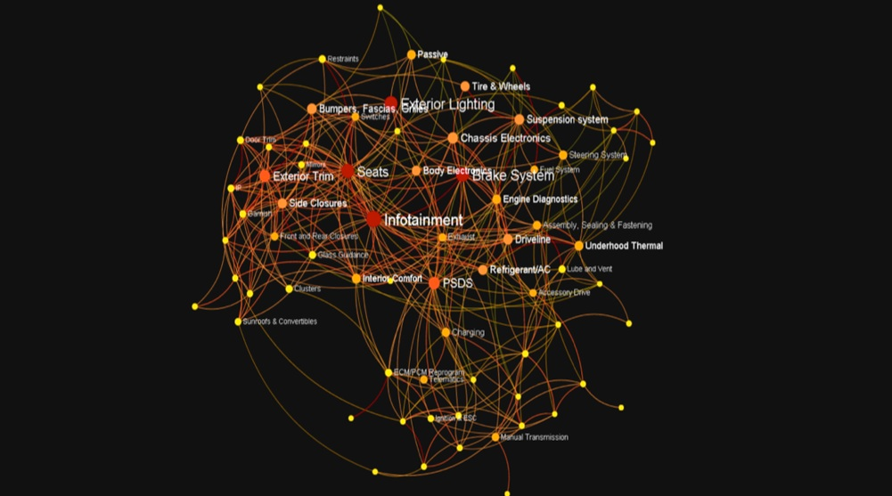
Notes:
<number>

Slide 16

Notes:
<number>

Slide 17
This is all great, but is big data just around to get better dates and make a ton of money?
Notes:
<number>

Slide 18
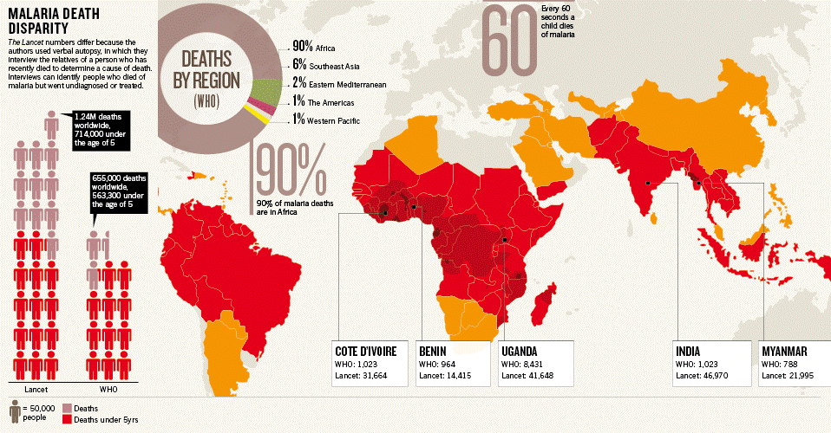
Notes:
<number>

Slide 19
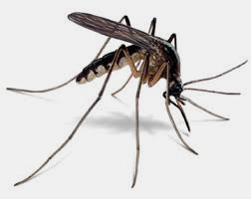
Notes:
<number>

Slide 20

Notes:
<number>

Slide 21

Notes:
<number>

Slide 22
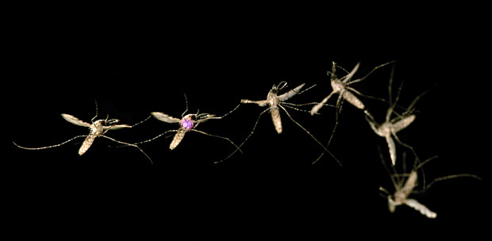
http://www.intellectualventures.com/
Notes:
<number>

Slide 23
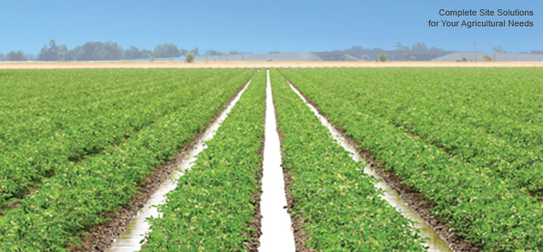
Notes:
<number>

Slide 24
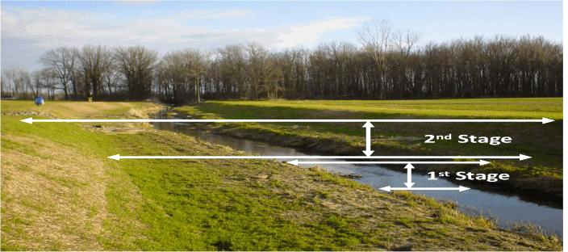
Notes:
<number>

Slide 25
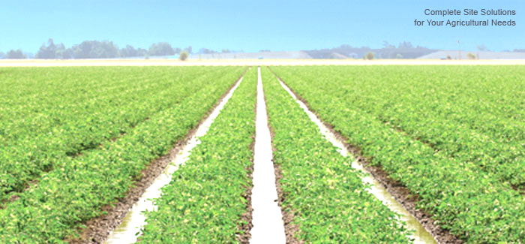
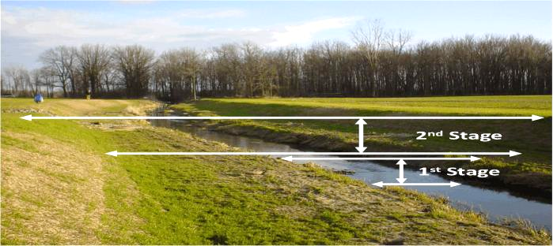
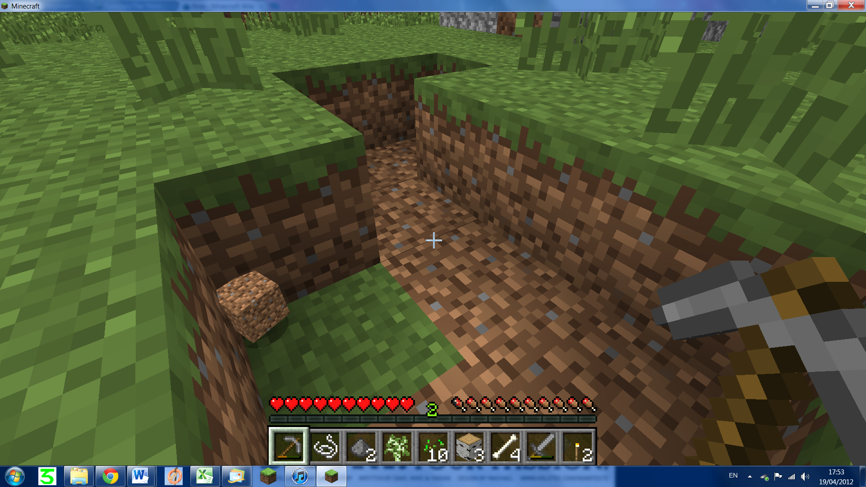
Notes:
<number>

Slide 26

Notes:
<number>

Slide 27
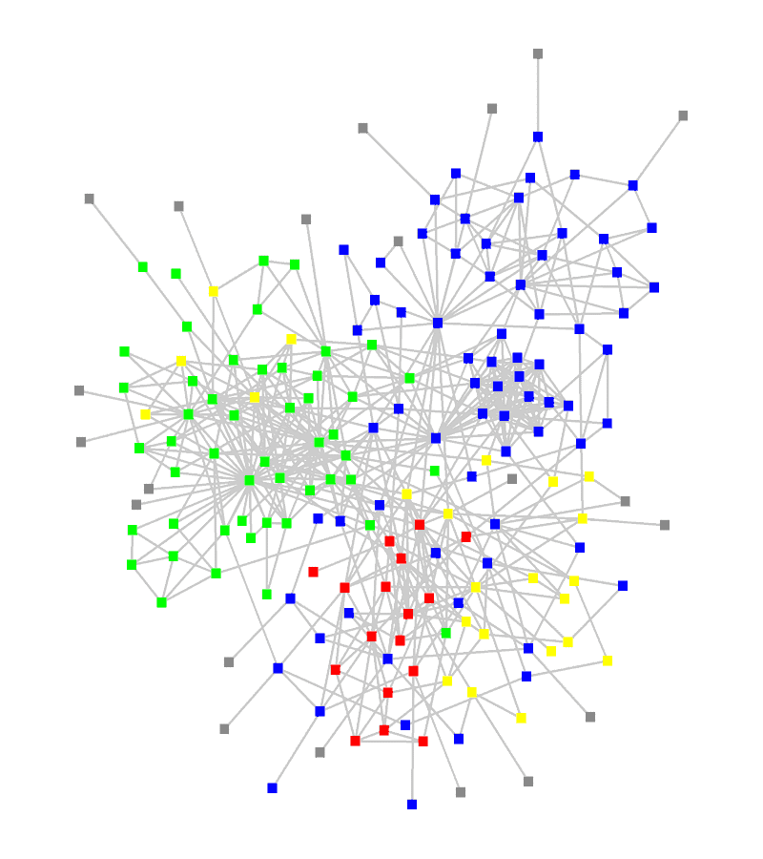
Notes:
<number>

Slide 28
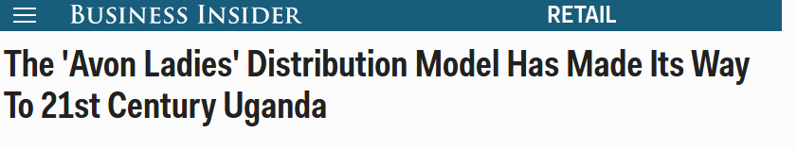
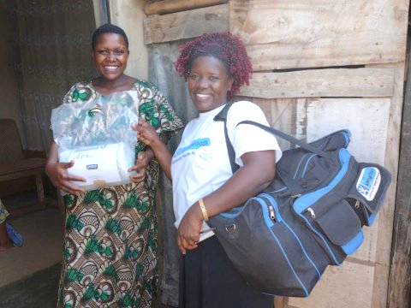
Notes:
<number>

Slide 29
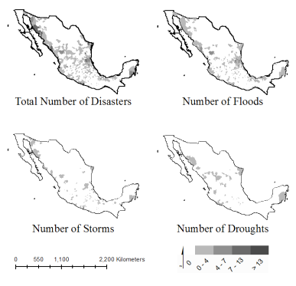
Notes:
<number>

Slide 30
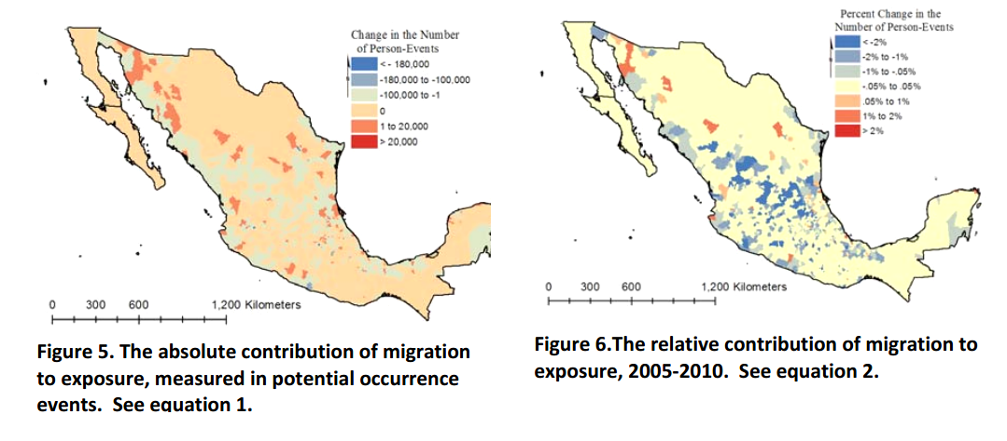
Notes:
<number>

Slide 31
From Here
First Half: Learning the Methods in an Applied Context
Second Half: Choose from a Question that Interests you
World Bank – Environmental Change & Emissions
Save the Children – Health, Safety, and Child Deprivation in Urban Areas
National Center for State Courts - Metrics of Procedural Legal Justice
Notes:
<number>

Slide 32
Syllabus
Notes:
<number>

